Slide 1


Java ee
(ADVANCE JAVA)
Lecture-4

Slide 2
Today’s Agenda
Introduction To HttpServlet
Differences With GenericServlet
Introduction To doGet( ) and doPost( )
Writing Servlet By Extending HttpServlet

Slide 3
Introduction To“HttpServlet” Class
As we all know the protocol that is mostly used for communication over the internet is HTTP.
So Oracle-SUN has provided us the derived class of GenericServlet called as HttpServlet.

Slide 4
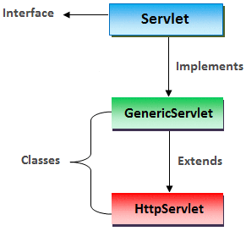
Introduction To“HttpServlet” Class
Java strongly recommends us that instead of inheriting GenericServlet we should inherit HttpServlet while creating our own servlet class

Slide 5
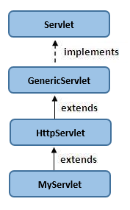
Extending The HttpServlet Class

Slide 6
Introduction To“HttpServlet” Class
This class extends GenericServlet and provides us some special doXXX()methods .
These methods are based on Http commands.

Slide 7
Introduction To“HttpServlet” Class
There are total 7 doXXX( ) methods given by the class HttpServlet each representing a specific HTTP command.
These methods are:
doGet()
doPost()
doHead()
doPut()
doDelete()
doOptions()
doTrace()

Slide 8
Introduction To“HttpServlet” Class
But out of them the two mostly used are the doGet() and doPost() methods .
This is because maximum request given by user is either Get or Post.
The HttpServlet class reads the HTTP request, and determines if the request is an HTTP GET, POST etc and then calls one the corresponding method.

Slide 9
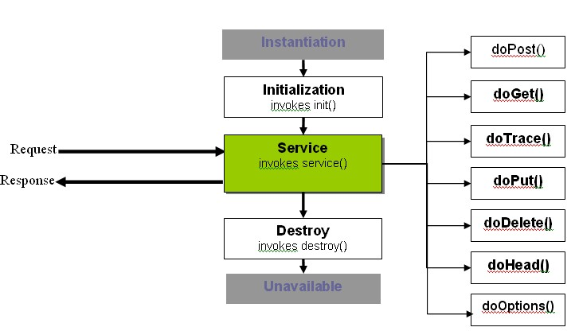
Diagram

Slide 10
An Important Point !
While extending the HttpServlet class we must never override the service() method.
This is because the class HttpServlet itself has overridden the method service() in such a way that it first detects the kind of request generated by the browser (Get or Post) and then calls the required doXXX() method.

Slide 11
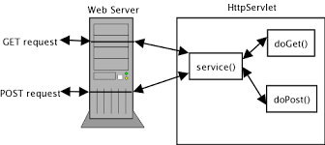
Diagram

Slide 12
Another Important Point!
HttpServlet is an abstract class but it doesn’t contain any abstract methods.

Slide 13
Another Important Point!
None of the doXXX( ) methods have been made abstract but still the class HttpServlet has been declared as an abstract class
Can you tell why ?

Slide 14
Another Important Point!
This is because none of the doXXX( ) methods contain any proper implementation.
They all have all default behaviours of returning a HTTP 405 Method Not Implemented error.
So the designers of JEE technology did not want that anyone should be allowed to instantiate HttpServlet class as it’s practically of no use.

Slide 15
Why doXXX( ) Methods Have Not Been Declared As abstract ?
This is because if those methods were all abstract, we would be forced to override all of them , even though our business requirements don't need it at all.

Slide 16
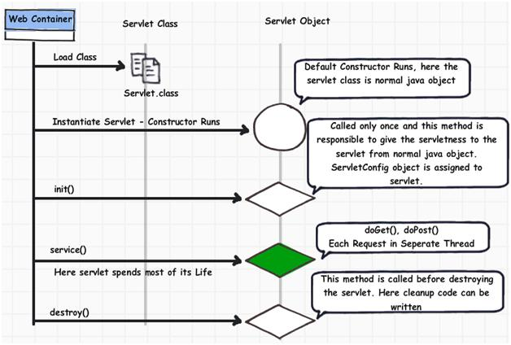
LifeCycle Of HttpServlet

Slide 17
LifeCycle Of HttpServlet
All the steps are same as previous, the only difference is that when the Container calls the service( ) method, then the implementation of service( ) given by HttpServlet class runs since programmer’s do not override this method.
But when the service( ) method calls the doGet( ) or doPost( ) method , then our implementations will run as we must have overridden doXXX( ) methods.

Slide 18
HttpServlet V/s GenericServlet
GenericServlet | HttpServlet
It is Generalized (protocol independent) class i.e. It does not support specific features of a particular protocol. | It purely supports HTTP protocol and should be used with HTTP protocol only
All methods are concrete except service() method. service() method is abstract method. | All methods are concrete (non-abstract).
service() should be overridden being abstract in super interface. | service() method need not be overridden rather we need to override doGet( ) or doPost( ) methods
Defined in javax.servlet package. | Defined in javax.servlet.http package.
Not in use nowadays | Practically used in today’s java based web applications

Slide 19
Prototypes Of doGet() And doPost()
protected void doPost(HttpServletRequest req,HttpServletResponse resp) throws ServletException,IOException
purotected void doGet(HttpServletRequest req,HttpServletResponse resp) throws ServletException,IOException

Slide 20
Exercise
Develop an Http based Servlet that displays current date and time in RED color whenever a request arrives.

Slide 21
Solution
import javax.servlet.*;
import javax.servlet.http.*;
import java.io.*;
import java.util.*;
public class MyDateTimeServlet extends HttpServlet
{
protected void doGet(HttpServletRequest req,HttpServletResponse resp)throws IOException,ServletException
{
resp.setContentType("text/html");
PrintWriter pw=resp.getWriter();
pw.println("<html><head><title>Date Time Display</title>");

Slide 22
Solution
pw.println("<style type='text/css'>");
pw.println("h3{ color: red;}");
pw.println("</style></head>");
Date today=new Date();
String str=today.toString();
pw.println("<body>");
pw.println("Current date and time : <h3>"+str+"</h3>");
pw.println("</body></html>");
pw.close();
}
}

Slide 23
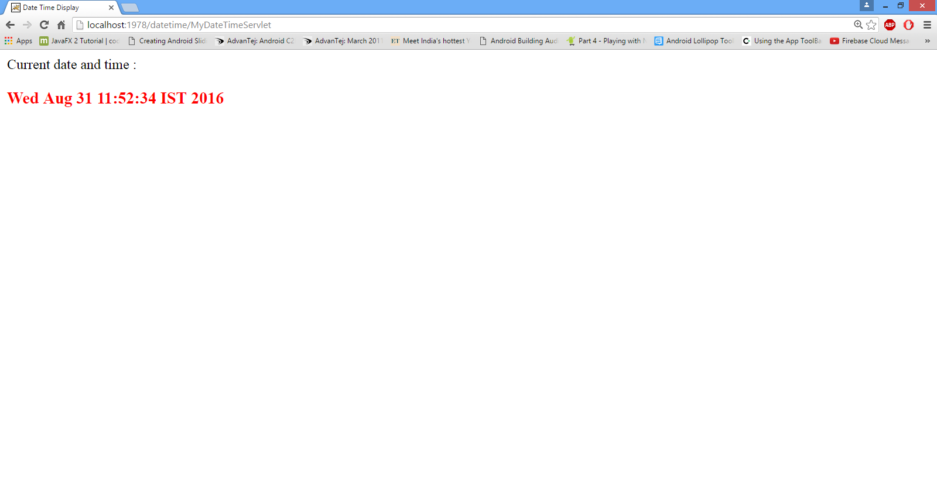
Output

Slide 24

End Of Lecture
For any queries mail us @: scalive4u@gmail.com
Call us @ : 0755-4271659, 9826686245
Agenda for Next Lecture:
Calling Servlets Using HTML Page
Obtaining Client Info
Methods Of ServletRequest and HttpServletRequest
Reading Form Parameters

